Slide 1


INR(₹)-USD($)
TIME SERIES FOR EXCHANGE RATE
Team Members :
Harika
Sri Hari
Sumit Gulyan
Jagadeesh

Slide 2
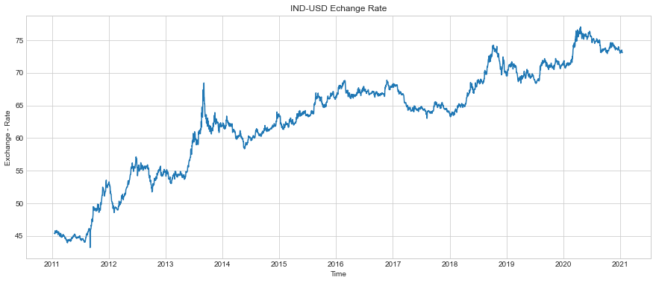
INR – USD EXCHANGE RATE DURING THE 2011 TO 2020 (LINE-PLOT)

Slide 3
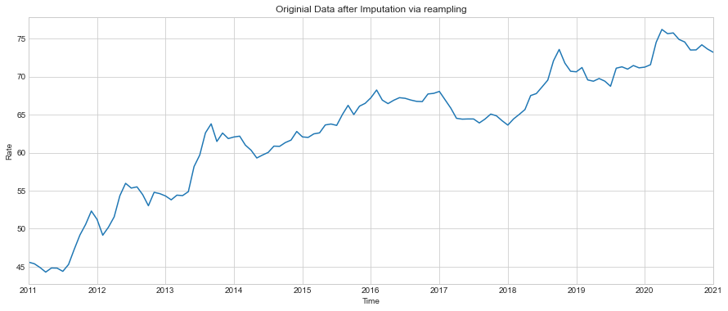
INR – USD EXCHANGE RATE AFTER IMPUTATION via RESAMPLING

Slide 4
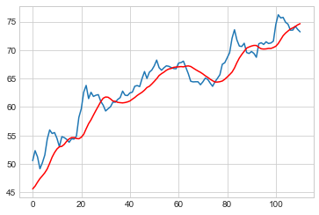
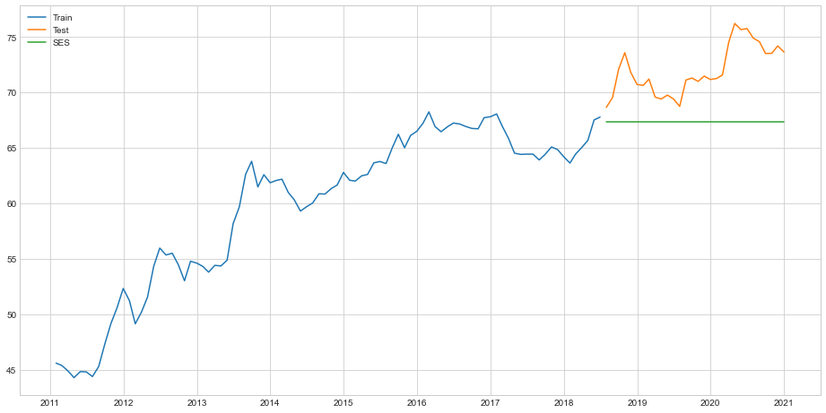
MOVING AVERAGE
SIMPLE EXPONENTIAL SMOOTHNING
TEST RMSE : 7.012
TEST RMSE : 5.174

Slide 5
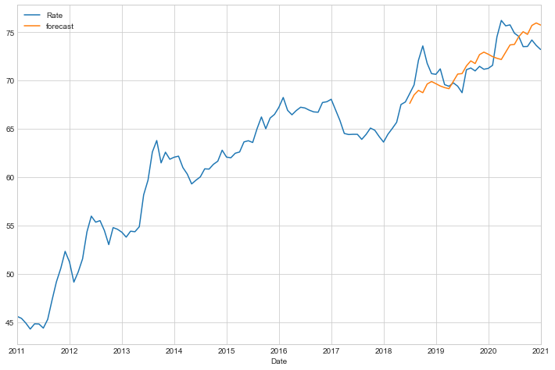
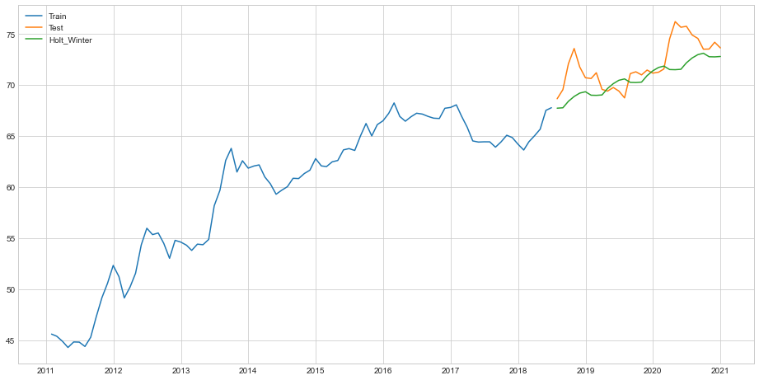
ARIMA PLOT
HOLT’S WINTER METHOD PLOT
TEST RMSE : 2.648
TEST RMSE : 2.128

Slide 6
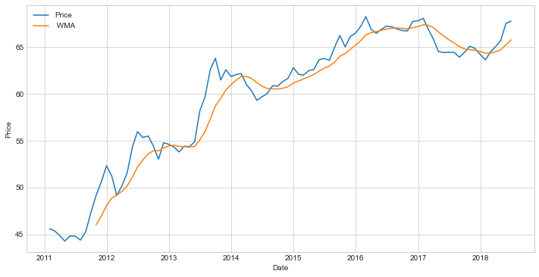
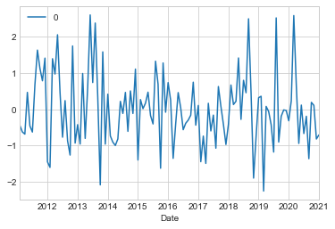
WEIGHTED MOVING AVERAGE
ARIMA RESIDUAL PLOT

Slide 7
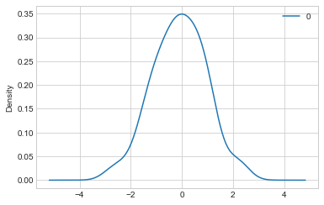
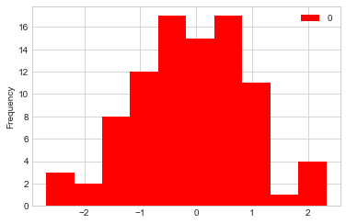
NORAMLACY PLOT
RESIDUAL HISTOGRAM

Slide 8
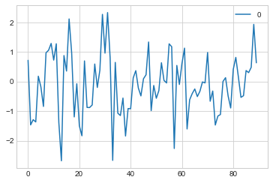
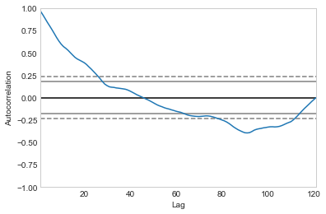
HOLT’S WINTERRESIDUAL PLOT
AUTO CORRELATION

Slide 9
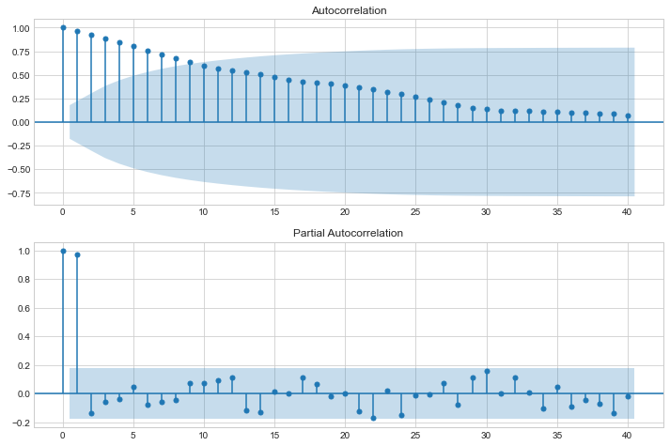
CORRELATION PLOT FOR THE DATASET
AUTO CORRELATION
PARTIAL AUTO CORRELATION

Slide 10

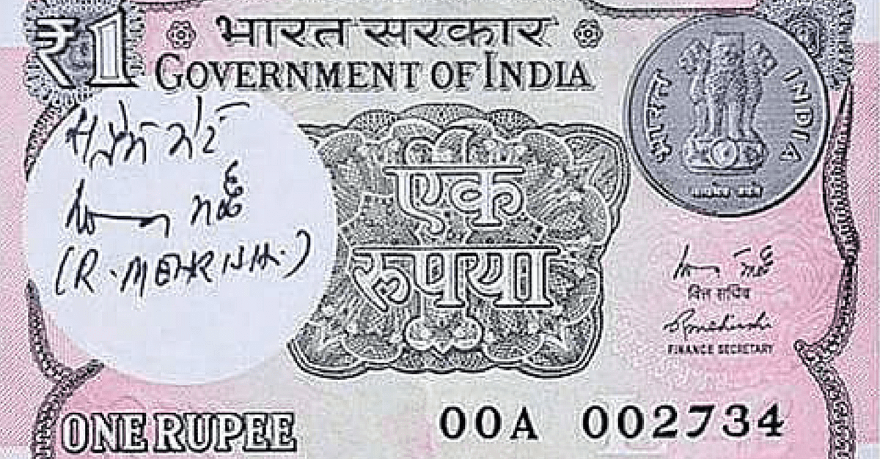
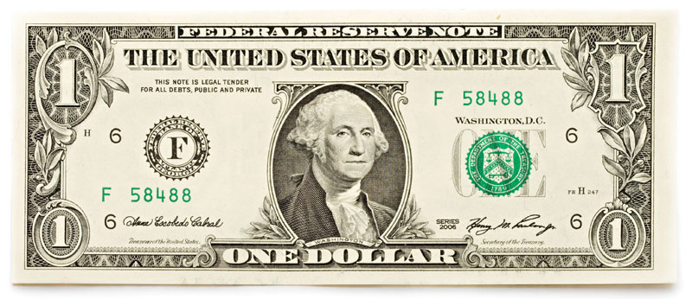
MY TEAM

